Slide 1
Predicting churn for Google merchandising store

Slide 2
Problem Statement & Objective
Problem:
82.6% visitors won’t come back in 30 days
XX% of these visitors will drop out permanently from the platform
Objective:
Reduce churn rate from 82.6% to XX%, or successfully retain XX customers
Execute marketing campaign within a budget of $XX
Positive return on investment, assuming that customer life-time value is $100

Slide 3
How we obtained data
The data was queried from Google Bigquery, then stored in Google Cloud as multiple slices. I used pyspark to connect these slices back together and store the final file in Google Drive
The dataset consists of daily entries from Jul 2016 to Jul 2017.
There are more than 900K entries and 16 columns.

Slide 4
Feature engineering – historical behaviors
From raw data, create features that summarize visitors’ behaviors in the last 7/15/30 day windows:
Total visits
Total purchases
Total time on site, etc.
The gaps between current visit with the last/first visit
Compare average daily visits with current date visits by channel

Slide 5
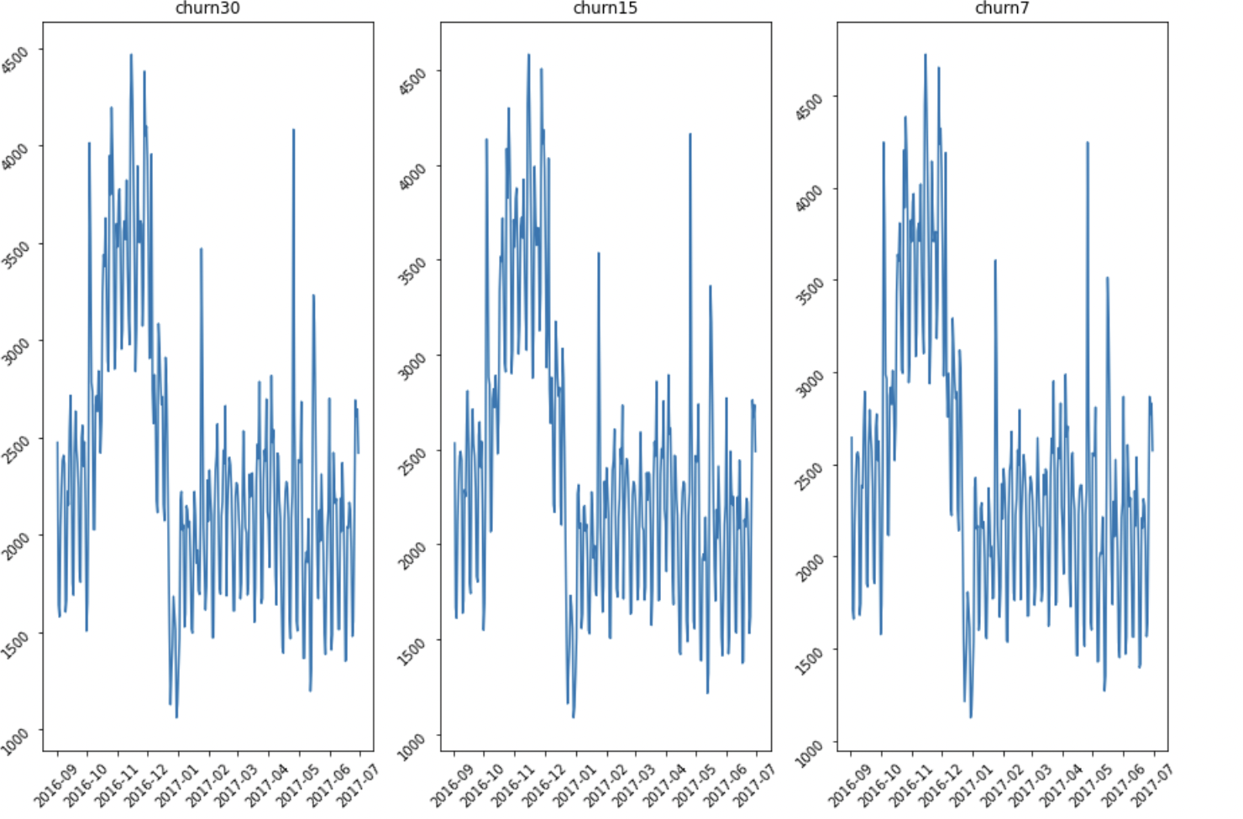
Data Exploration – Churn Definition
Since all 3 metrics follow the same trend, we will define churn mainly based on business consideration. 7 days and 15 days are usually too short to expect customers to come back, especially for non-essential products. Therefore, we will go with 30 days timeframe

Slide 6
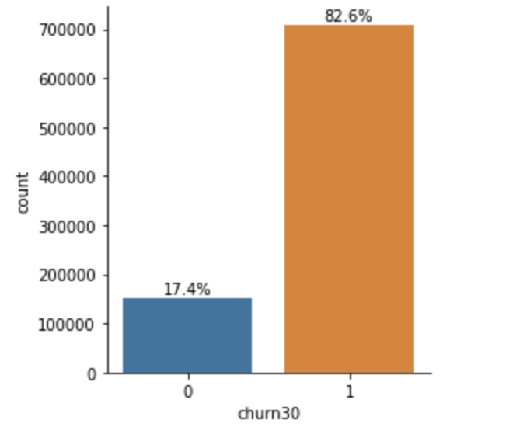
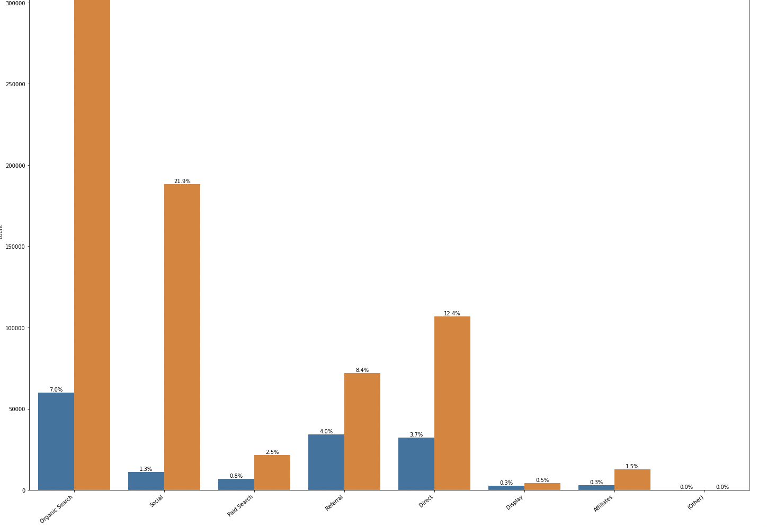
Data Exploration – Distribution
The dataset is imbalance: 17.4% not churned and 82.6% churned
Display, referral, and paid have the highest not churned:churned ratios (60%, 47.6%, 32%), whereas social has the lowest one (5.9%)

Slide 7
Data Exploration – IV Calculation
Find categorical features in the dataset:
The data type is object OR
There are between 2 and 20 unique values (more than 20 are too granular, hence not meaningful to classify)
Transaction data are exception: There are fewer than 20 unique values, but these should be treated as continuous

Slide 8
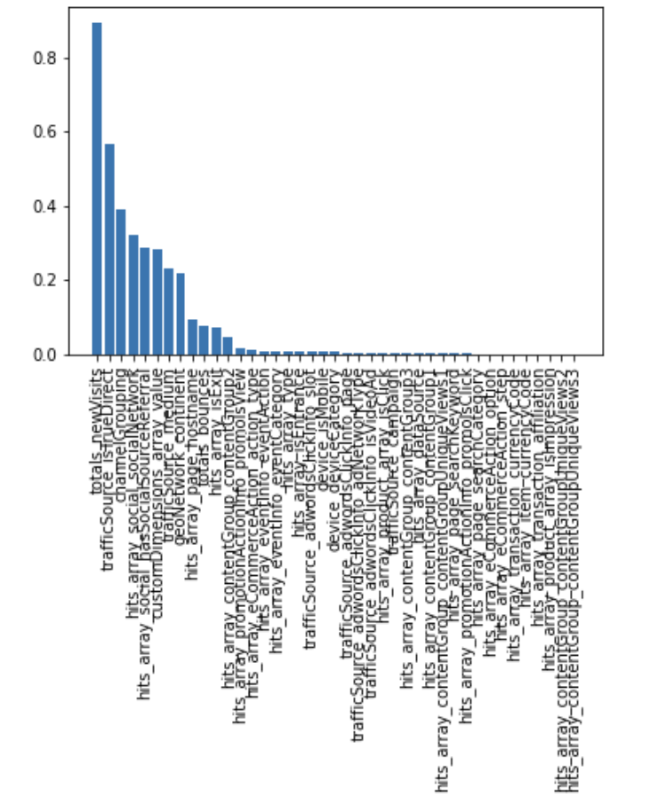
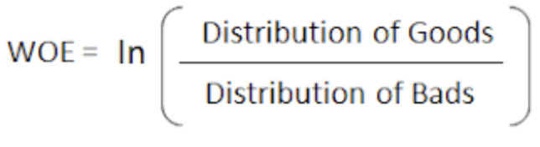

Data Exploration – IV Calculation

Slide 9
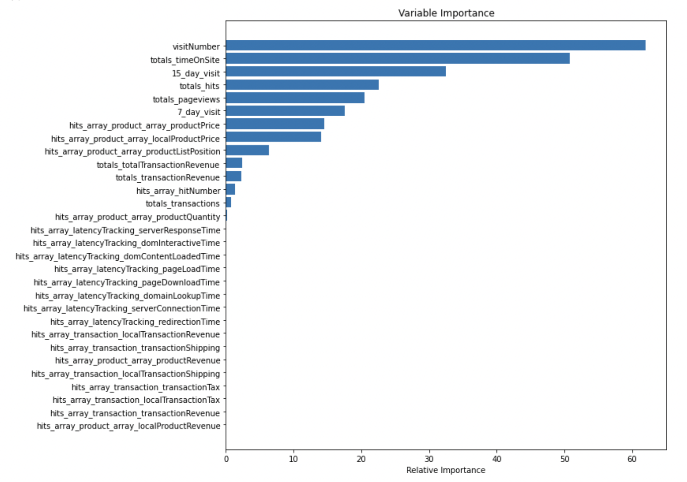
Data Exploration – Feature Selection
Using random forest model, we selected the top 13 features based on relative feature importance

Slide 10
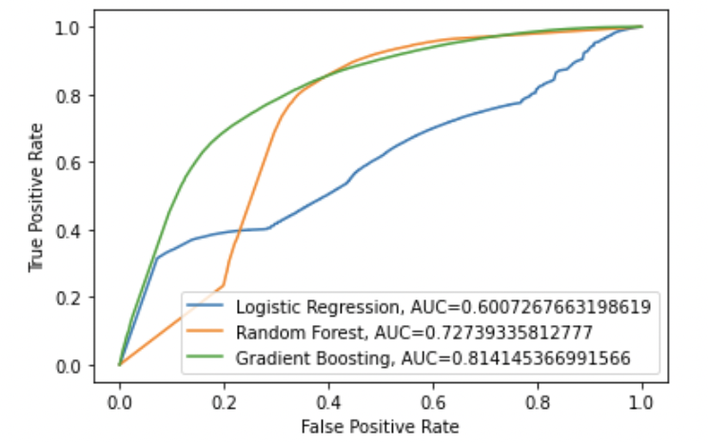
Modeling – Model Selection
Models considered:
Logistics Regression
Random Forest
Gradient Boosting
We selected GBM as it has the highest AUC score of 0.81

Slide 11
Modeling – Parameter Tuning
We ran randomized search CV for these parameters:
Learning rate
Max depth
Subsample
Min weight fraction
N-estimators

Slide 12
Assumptions
Assuming life-time value of a customer is $100 if he or she does not churn and we will be spending $10 per customer in our retention marketing campaign. Not churned customers tend to be more engaged and have higher chance of adopting our promo. We will test 3 scenarios: 1) 10% promo adoption rate among both "not churned" and "churned" groups 2) 10% adoption rate among the churned, 20% among the not churned group 3) 10% adoption rate among the churned group and 40% among the not churned group. We also assume that 20% of the high churn propensity who adopt our promo will end up not churning

Slide 13
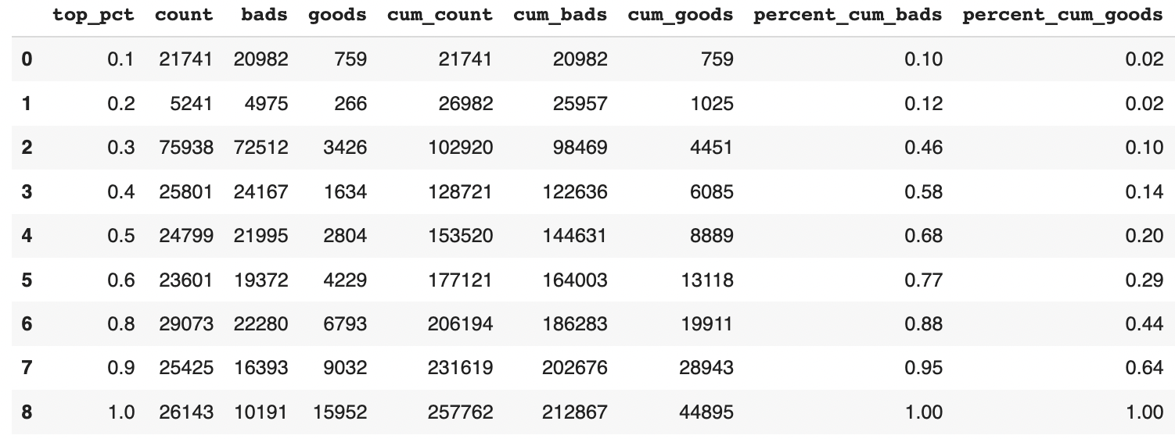
Recommendations
By focusing on the top percentiles, we target more churned customers than not-churned ones. E.g. Top 20 percentile contains 12% churned and only 2% not churned

Slide 14
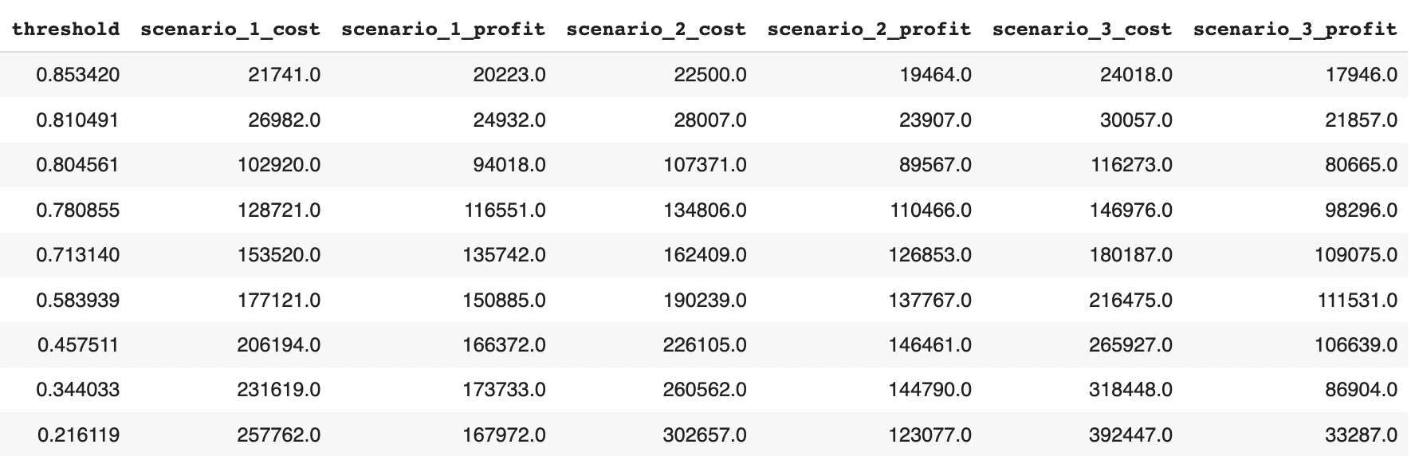
Recommendations

Slide 15
Recommendation
Scenario 2 and 3 are more realistic: Not churned customers are those inherently interested in our products and more receptive to our marketing effort, hence we can expect them to be more likely to use the promo.
The profit peaks at 80th percentile for scenario 2 and 60% for scenario 3.
Marketing team may have budget constraints and depending on the projected promo redemption rate, we can decide how many people to target in the campaign.
Assuming we are leaning toward scenario 3 and the marketing budget is $200k, we'll then decide to target the 40th percentile of population (153k people with highest probability to churn)

